Slide 1

Fern Bacon Middle School
“A NEW ERA OF EXCELLENCE”
Mary Coronado, Principal
Daniel Crenshaw, Assistant Principal
Laura Phillips, Learning Support Coordinator

Slide 2
TEST STRONG!
Purpose: To take pride in doing your best on the test for your school, for your family, and for yourself. It’s your time to
shine.
OBJECTIVE: To share as much testing information to prepare your mind for TESTING.
Notes:
2013-14 Vision / BHAG comes out of the 3 circles

Slide 3
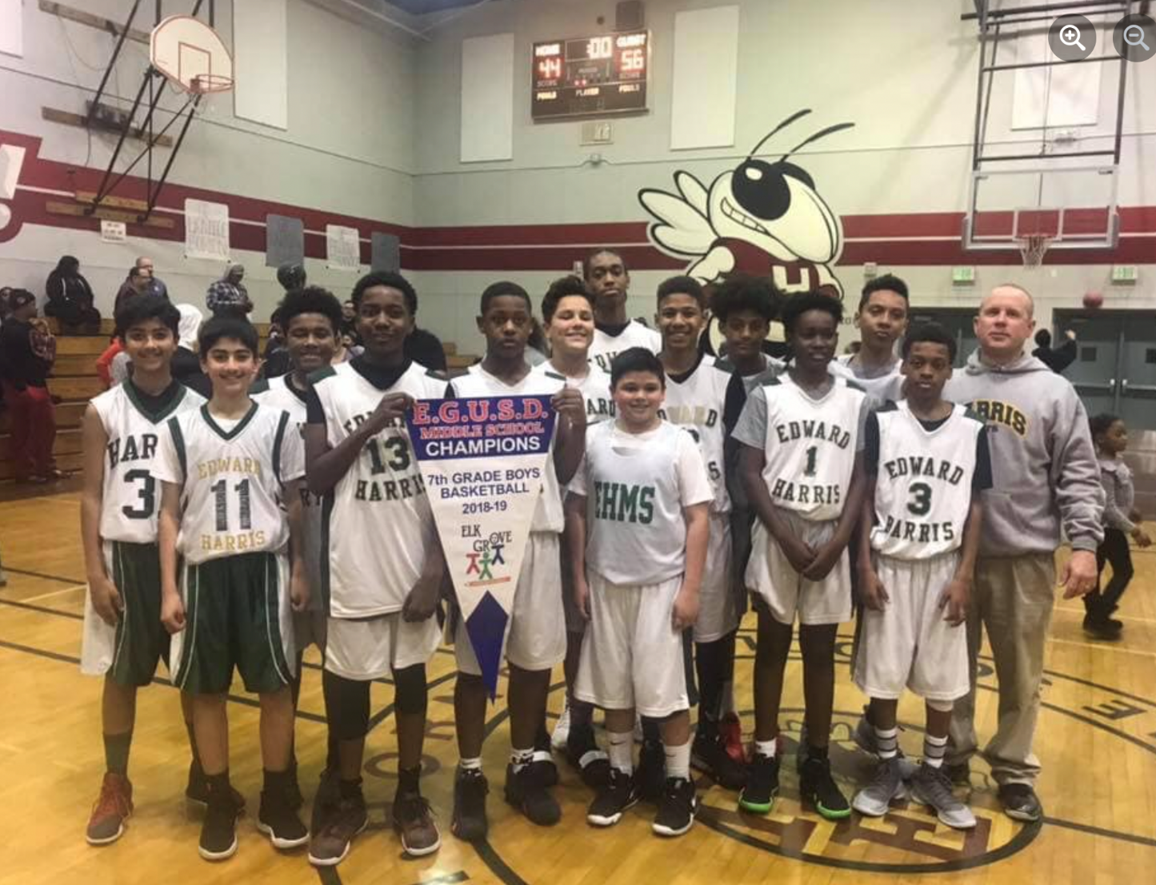
It’s not how big you are, it’s how big you play!

Slide 4
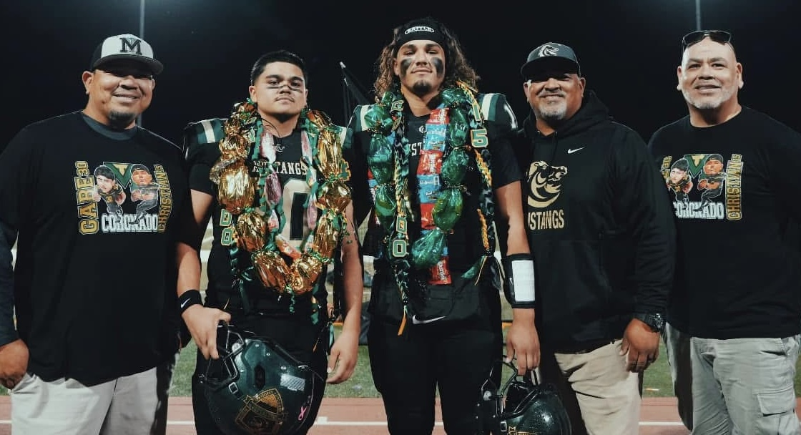

Slide 5


Slide 6

TESTING INFORMATION
  SBAC – SMARTER BALANCED ASSESSMENT CONSORTIUM
      CAT – COMPUTER ADAPTIVE TEST
      PT – PERFORMANCE TASK
      TEST IN ELA AND MATH
      8th Grade to test in SCIENCE

Slide 7

TESTING INFORMATION
Students are only testing in one subject each day during the morning. We will test on TUESDAYS & WEDNESDAY. Extra time has been built into the schedule on Fridays.
Students will stay on their regular schedule during testing for ELA. You will be testing with your 2nd Period teacher during an extended block of time for testing. Science will be testing in on a special schedule called BLOCK SCHEDULE.

Slide 8

TESTING INFORMATION
Students will be expected to keep working through the entire testing block. Stay focused.
If students finish early, students are expected to close their Chromebook & do a QUIET ACTIVITY until the testing period is over to respect the students who are still working.
Students will report to their Testing Room / or 2nd Period teacher to test.

Slide 9
Testing Schedule
Period | Time | Minutes
Entry Bell | 8:10
1 | 8:15-8:39 | 24
TESTING ROOM | 8:45– 11:30 | 2 HRS 45 minutes
2 | 11:36 – 12:00 | 24
LUNCH | 12:00 – 12:30 | 30
3 | 12:37 – 1:00 | 23
4 | 1:05 – 1:28 | 24
5 | 1:33 – 1:56 | 23
6 | 2:02 – 2:25 | 23

Slide 10
Testing Schedule
8:45-11:30 AM
Time | Tasks
8:45 – 9:15 | Take role, secure backpacks, pass out Chromebooks, log-in (30 minutes)
9:15 – 9:20 | Break
9:20 – 10:20 | Recommended CAT / PT time (60 minutes)
10:20 – 10:25 | Break
10:25 – 11:30 | Continue CAT / PT (50 minutes) Finish / clean-up (15 minutes)

Slide 11

TESTING INFORMATION
CAT adjusts the level of difficulty TO YOUR ABILITY. This is not a timed test.
Must answer all test items on a page to get maximum points.
MAY not return to a test segment once completed .
Must complete both the CAT and PT to get an overall score.
Must answer all test items before the test can be submitted.
You MUST select END TEST to submit test.
You are scored on both the number of correct answers and the difficulty of the questions completed.

Slide 12
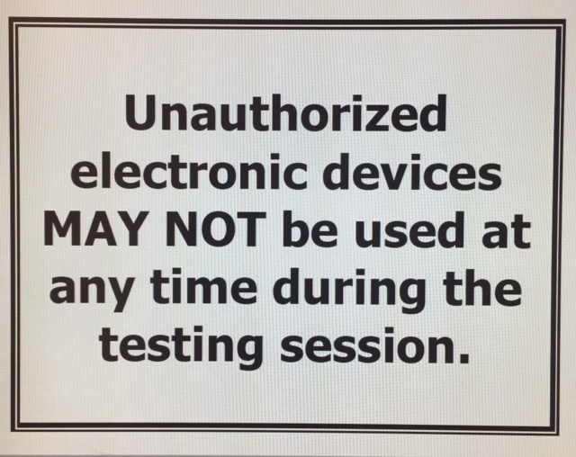
CELL PHONE USE IS PROHIBITED
All cell phones will be stored in backpacks in front of the classroom. No exceptions!

Slide 13




TESTING SCHEDULE
Monday | Tuesday | Wednesday | Thursday | Friday
APRIL 28 | APRIL 29 | APRIL 30 | MAY 1 | 2
Regular Schedule | SBAC ELA | SBAC ELA | Shortened Day | Extra time to finish
5 | 6 | 7 | 8 | 9
Regular Schedule | SBAC MATH | SBAC MATH | Shortened Day | Extra time to finish
12 | 13 | 14 | 15 | 16
Regular Schedule | SBAC SCIENCE BLOCK Schedule Periods 1, 3, 5 | SBAC SCIENCE BLOCK Schedule Periods 2, 4, 6 | Shortened Day | SBAC PRIZE GIVEAWAY @ LUNCH
19 | 20 | 21 | 22 | 23
Extra Time | Extra Time | Extra Time | Extra Time | Last Day for testing
26 | 27 | 28 | 29 | 30
Memorial Day- No School | 8th Grade End-of-Year Field Trip | Girls Inspired Field Trip |  | Heritage Festival

Slide 14



TEST-TAKING TIPS
The night before the test get to bed early. Don’t stay up late. Your brain and body need sleep to function well.
Eat breakfast in the morning. You think better when you have a full stomach.
Show up to school early so you won’t have to worry about being late.
Notes:
Model Campus
-Clean, Calm, Orderly, Welcoming (greeting of students to build good relationships but to reinforce your expectations of behavior)
-Teachers / Administrators modeling visibility and core values
Model Classrooms
What does this look like?
-classroom rules or standards of behavior clearly posted
-written procedures for all or most activities
-greeting of students
-lesson objective on the board
-agenda
-display of exemplary student work
-college wall
-proficiency wall
Why is this important?

Slide 15

TEST-TAKING TIPS
Focus carefully on any directions you teacher gives you.
Don’t worry about how fast other people finish their test; just concentrate on your own test.
I’m done! Not so fast – go back to review your answers making sure you didn’t make careless mistakes.

Slide 16

PAUSE RULES
LESS than 20 minutes
MORE than 20 minutes

Slide 17
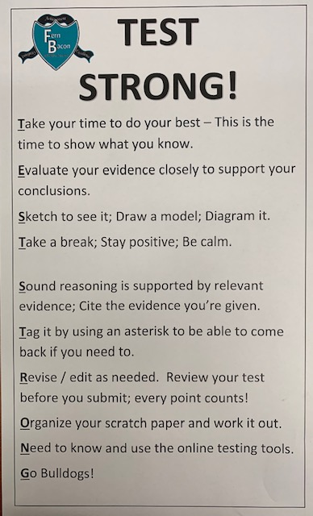
Test Strong!
Poster posted by your teachers
Usage of strong vocabulary choice is highly encouraged
CLAIM
EVIDENCE
REASONING

Slide 18


POSITIVE ATTITUDE
A positive attitude goes a long way towards success. POSITIVE SELF-TALK
No Pain, no Gain! Grapple with it.
Take a short mental time out.
Don’t give up.
Don’t leave anything blank.
If you really don’t know the answer, make your best guess.

Slide 19


Successful students:
Are here EVERY DAY on testing days
Are ON TIME to school and in class
Use their TEST STRONG! Strategies
TEST STRONG! PRIZES!

Slide 20
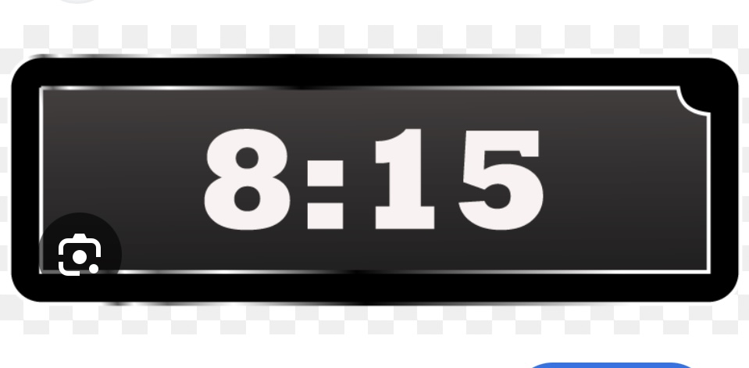
BE ON TIME. IF NOT, TEST IN LIBRARY.

Slide 21
SHOW ONE (1) YEAR’S GROWTH
4 | EXCEEDED
**3** | MET
2 | NEARLY MET
1 | NOT MET

Slide 22
FERN BACON STUDENTS WILL…
Take pride in doing your best on the test for your school, for your family, and for yourself. It’s your time to shine. PRIDE
Be a wise test-taker using your Test Strong! strategies; TEST-TAKING TIPS.
HAVE a positive attitude. The three most important words you can say to yourself,
  YES, I CAN
Just do YOUR BEST by staying FOCUSED. SHOW YOU KNOW. It’s your time to shine!

Slide 23


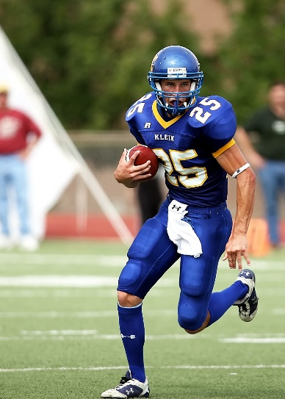

JUST DO YOUR BEST!
DREAMS DON’T WORK UNLESS YOU DO!

